Slide 1
Fundamental concepts of network planning

Slide 2
Introduction
Network planning is a crucial aspect of designing and managing various types of networks, including telecommunications, computer networks, transportation systems, and supply chains.
Effective network planning ensures that the network meets current and future demands, operates efficiently, and provides the required quality of service (QoS).

Slide 3
Capacity Planning
This is meant to determine the optimal number and type of resources required to meet expected demand and maintain desired performance levels.
Key Concepts
Demand Forecasting: Predicting future network usage based on historical data, trends, and user behavior.
Resource Allocation: Determining the quantity and distribution of resources such as bandwidth, servers, and storage.
Quality of Service (QoS): Ensuring that the network meets predefined service quality parameters, including latency, jitter, and packet loss.
Utilization: Balancing resource utilization to avoid both underutilization (waste) and overutilization (congestion).

Slide 4
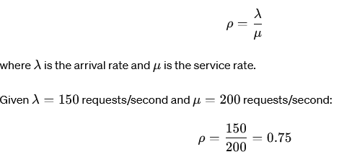
Example
A company expects its web server to handle an average of 150 requests per second. The server's average service rate is 200 requests per second. Determine if one server is sufficient and calculate the utilization.
Solution:
Utilization (ρ) is calculated as:

Slide 5
Traffic Engineering
To manage and optimize the flow of traffic within the network to enhance performance and avoid congestion.
Key Concepts
Traffic Patterns: Understanding the typical flow of data through the network, including peak times and high-traffic routes.
Routing: Determining the best paths for data to travel through the network to minimize delays and avoid congestion.
Load Balancing: Distributing traffic evenly across network resources to ensure no single resource is overwhelmed.
Congestion Control: Techniques to prevent and manage congestion in the network, such as traffic shaping and prioritization.

Slide 6
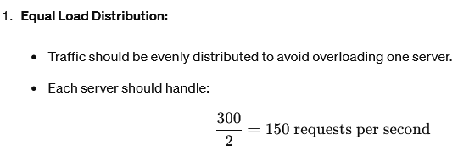
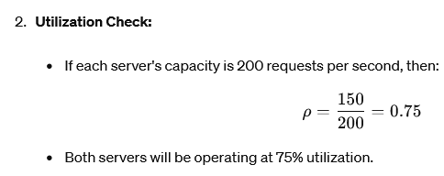
Example
A data center has two servers with equal capacity. During a certain period, the incoming traffic is 300 requests per second. How should the traffic be distributed between the servers?
Solution

Slide 7
Performance Analysis
To evaluate and improve the performance of the network based on key metrics.
Key Concepts
Throughput: The amount of data successfully transmitted through the network per unit of time.
Latency: The time it takes for data to travel from the source to the destination.
Jitter: The variability in packet arrival times, which can affect the quality of real-time communications.
Packet Loss: The percentage of packets that are lost during transmission, impacting data integrity and quality.

Slide 8
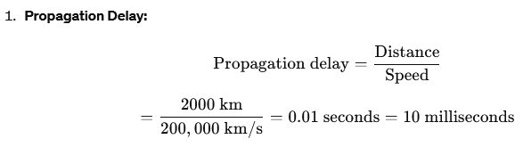

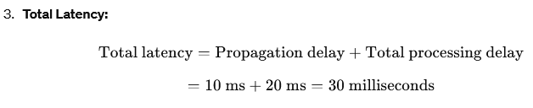
Example
Calculate the average latency for a packet traveling from point A to point B in a network if the distance is 2000 kilometers, and the signal travels at 200,000 kilometers per second. Also, consider an additional processing delay of 10 milliseconds at each of two intermediate routers.
Solution:

Slide 9
Reliability and Fault Tolerance
To ensure the network can continue operating smoothly in the event of failures or unexpected issues.
Key Concepts
Redundancy: Implementing duplicate components or paths to provide alternatives in case of failure.
Failover Mechanisms: Automatic switching to a backup system or component when a failure is detected.
Disaster Recovery: Plans and processes to restore network functionality after a major failure or disaster.
Mean Time Between Failures (MTBF): The average time between failures of a system or component.
Mean Time to Repair (MTTR): The average time required to repair a failed component or system.

Slide 10
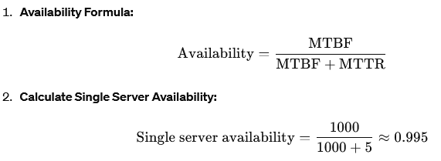
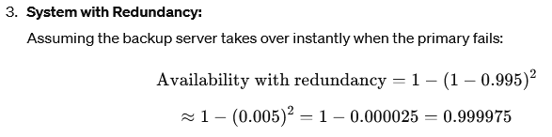
Example
A critical server has an MTBF of 1000 hours and an MTTR of 5 hours. To ensure high availability, a backup server is added. Calculate the availability of the system.
Solution

Slide 11
Scalability
To design the network so it can handle increased demand and grow without a significant loss of performance.
Key Concepts
Horizontal Scaling: Adding more devices or systems to handle increased load (e.g., adding more servers).
Vertical Scaling: Increasing the capacity of existing devices or systems (e.g., upgrading a server's hardware).
Elasticity: The ability of the network to dynamically adjust resources based on current demand.
Modularity: Designing the network in such a way that new components can be easily added or removed.

Slide 12
Example
An e-commerce website experiences varying traffic loads, from 500 users per hour during off-peak times to 5000 users per hour during peak times. The website is hosted on a cloud platform. How can the website be scaled to handle this variability?
Solution:
Elastic Cloud Resources: Use a cloud provider that supports auto-scaling to dynamically allocate resources based on traffic.
Horizontal Scaling: During peak times, the system can add more instances (servers) to handle increased load. For example, if each instance handles 1000 users, scale from 1 instance during off-peak to 5 instances during peak.
Vertical Scaling: Upgrade instance types to more powerful configurations during peak times if horizontal scaling alone is insufficient.
Implementation:
Configure auto-scaling rules in the cloud platform to automatically add or remove instances based on user load.
Monitor performance metrics to

